Slide 1
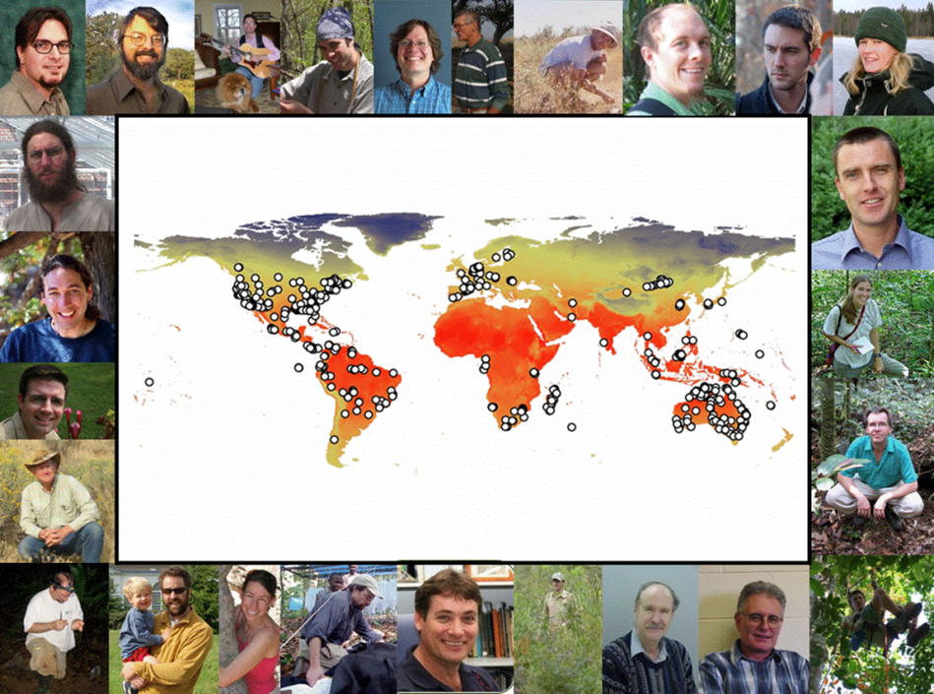
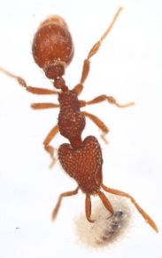
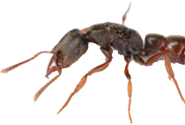
Understanding Ant and Butterfly Diversity in a Changing World
Clinton Jenkins, Andrea Lucky, Nathan Sanders, Michael Weiser, Matthew Fitzpatrick, Robert Dunn, Benoit Guénard, Sarah Diamond, Beth Gardner…
Global & continental diversity patterns
Climate change
Individual species modeling
Missing ant diversity
Urbanization and butterfly phenology

Slide 2
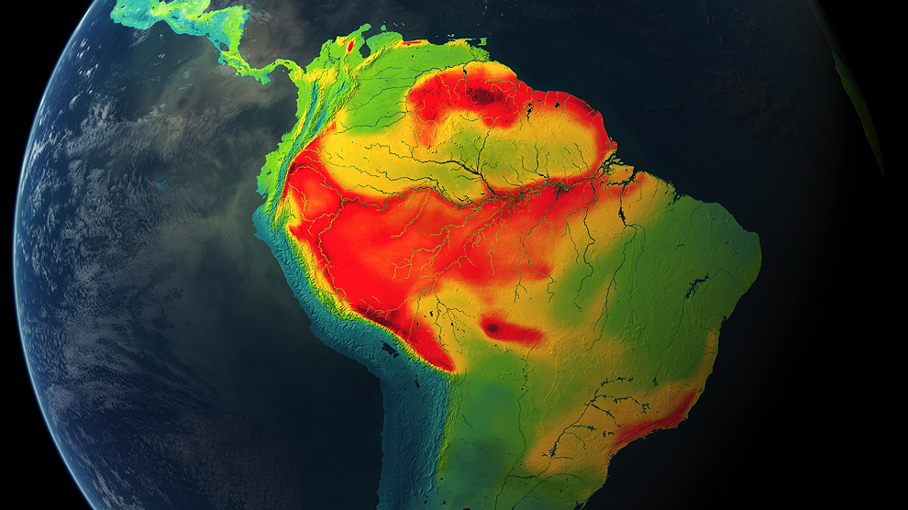
Vertebrates are well known…
…but most animals are insects

Slide 3
Ant Diversity in Light of Climate Change
Generalized Linear Model
Climate: temperature, precipitation, aridity
Geography: biogeographic region
Interactions: region * climate
Jenkins et al. (2011) Diversity and Distributions

Slide 4
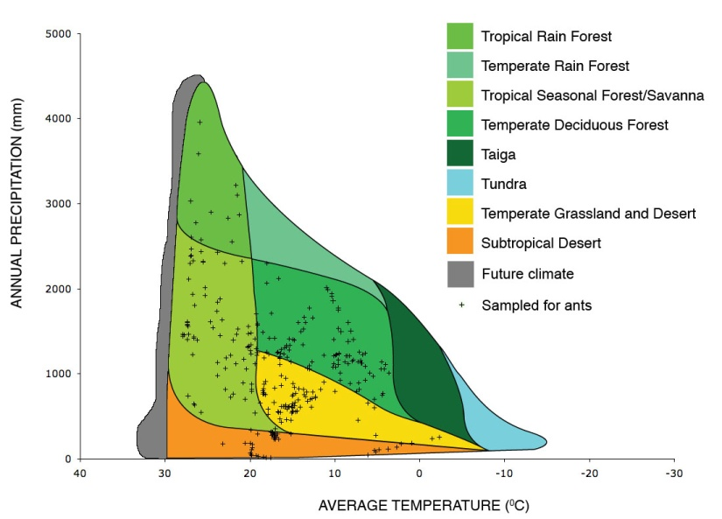
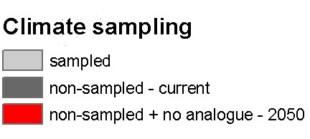
Gaps in our Knowledge
Lots of ant data
Not so many data
No-analogue climates
& new biomes
Precipitation
Temperature
Lots of ant data
No-analogue
climates

Slide 5
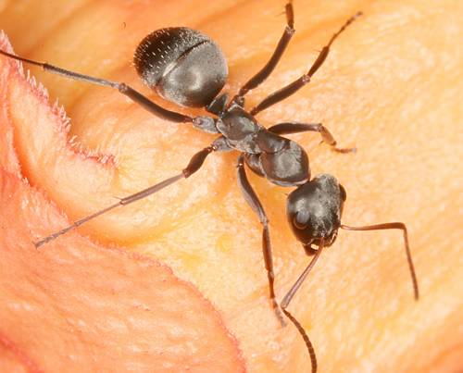
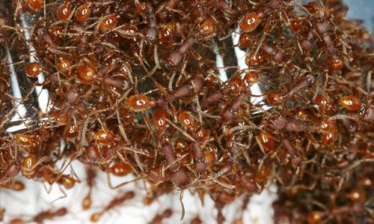
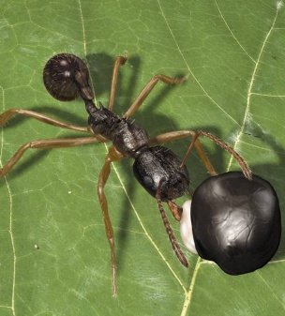
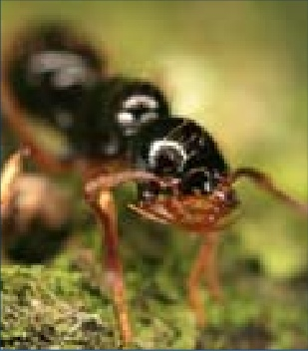
Findings
Ant diversity generally increases with temperature
At the highest temperatures diversity is also the most variable, ranging from 1 to 145 species
Future climates will be more like these hot places, which are also where we know the least

Slide 6
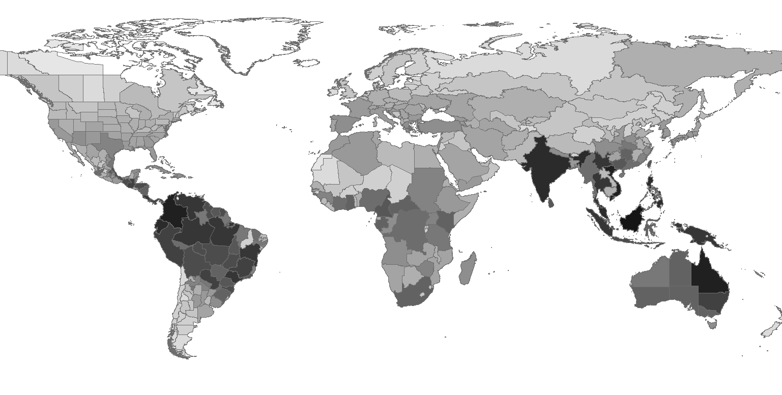
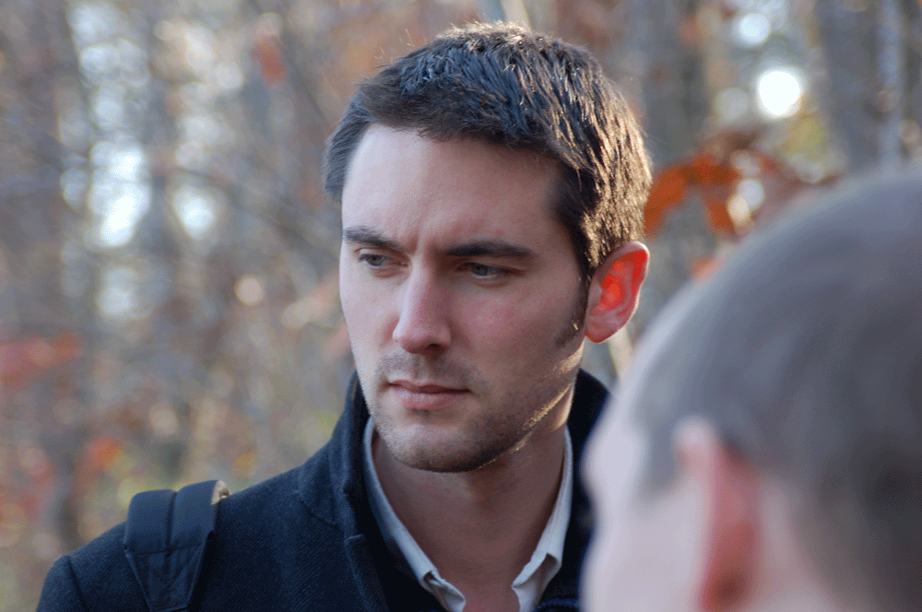
Generic diversity of ants
Benoit Guénard
http://www.antmacroecology.org/ant_genera/index.html

Slide 7
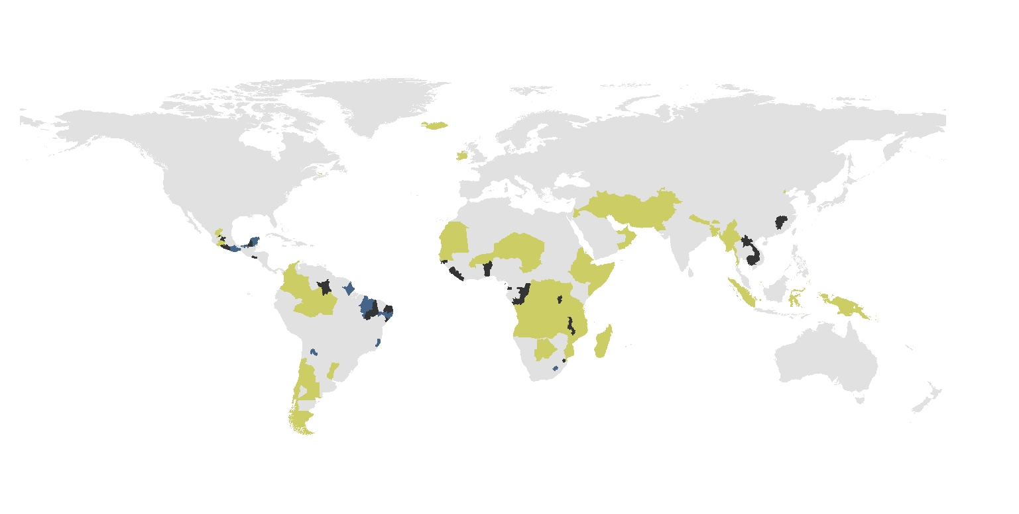
Missing diversity
Predicted by the expert model
Predicted by the environmental model
Predicted by both models
Model of generic diversity based on better sampled regions

Slide 8
Predicted
from Vertebrates
Empirical
Jenkins et al. (in press) Diversity and Distributions

Slide 9
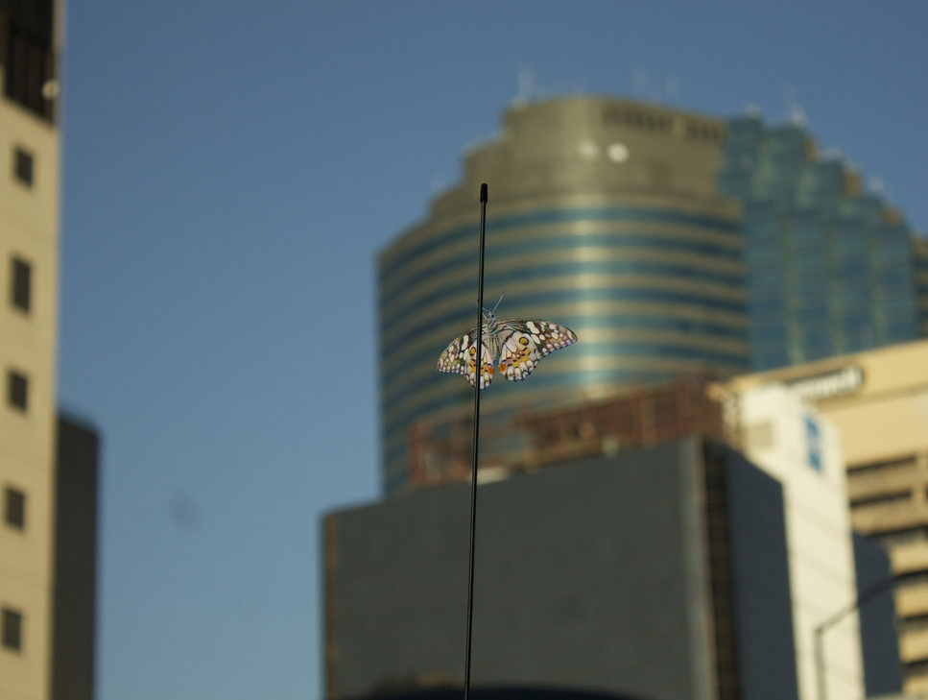
Butterfly responses to urbanization and climate change
Citizen science observation-based approach

Slide 10
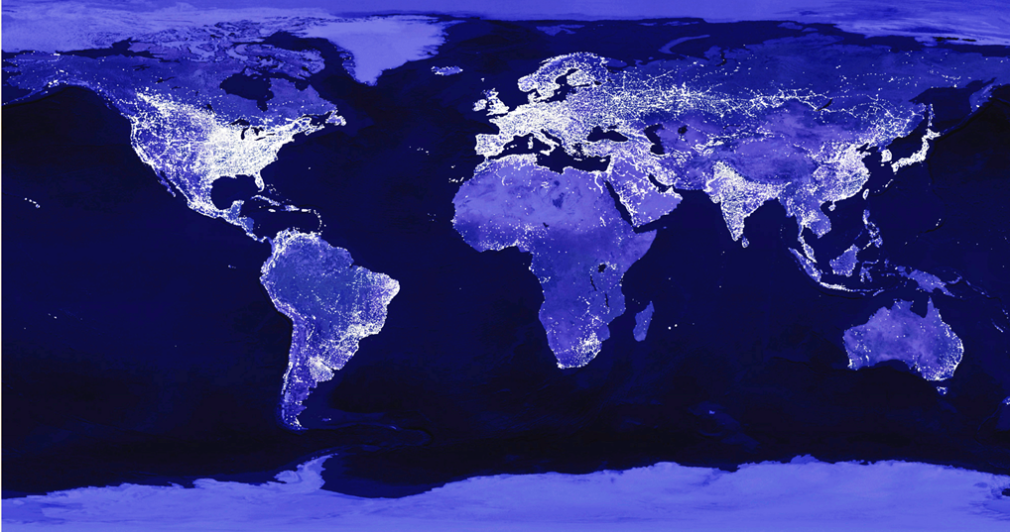
Multiple sources of change
Climate warming ~ 3 ° C
Shifts toward earlier phenology
Phenology – timing of life cycle events (leaf out, insect emergence, senescence)
Key indicator of biological responses to climate change
(Intergovernmental Panel on Climate Change; IPCC)
Shifts toward earlier phenology
Urban warming ~ 3 ° C
Notes:
Given that there are an estimated 8.7 million eukaryotic species on earth, this places a premium on identifying specific regions and taxonomic groups most at risk from climate change.

Slide 11
Multiple sources of change
Climate warming ~ 3 ° C
Δ °C
Shifts toward earlier phenology
Will the joint impacts of climate and urban warming continue to shift phenology earlier?
Shifts toward earlier phenology
Urban warming ~ 3 ° C

Slide 12
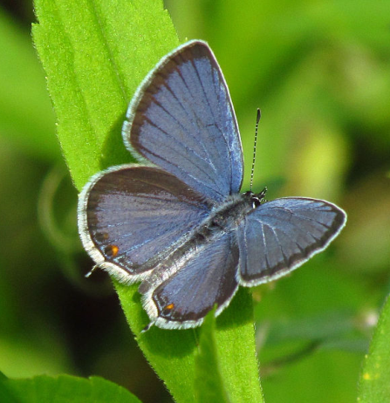
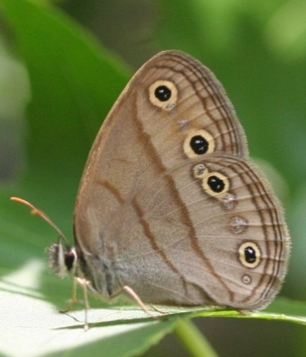
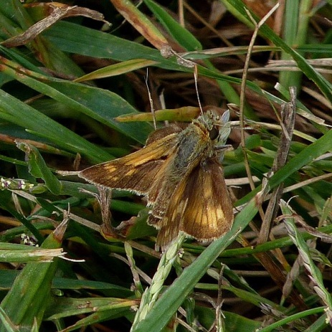
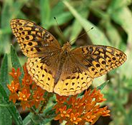
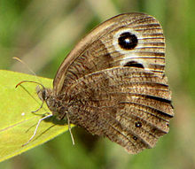
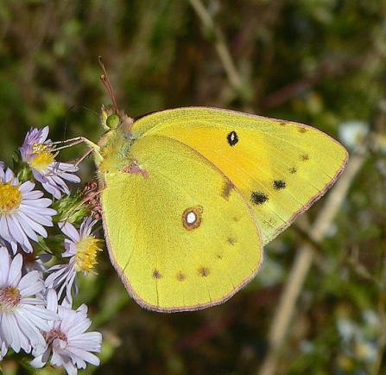
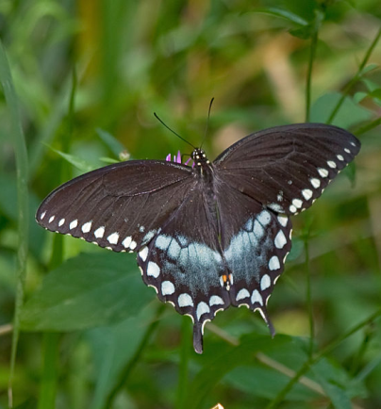
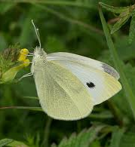
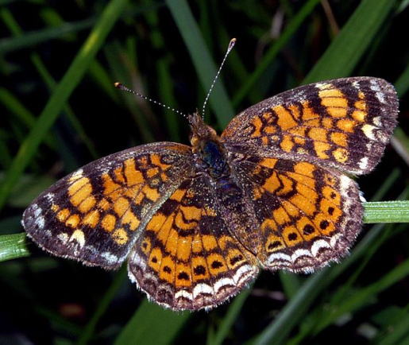
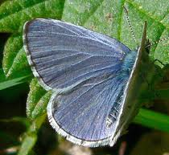
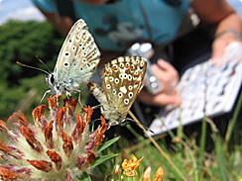
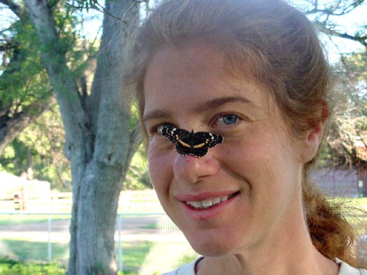
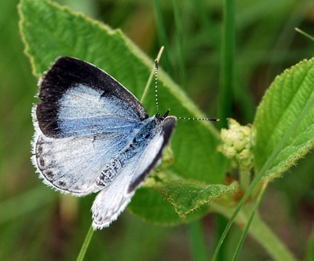
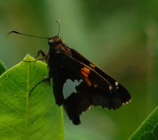
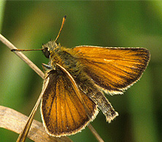
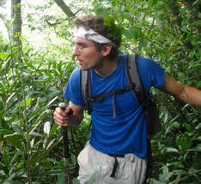
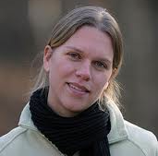
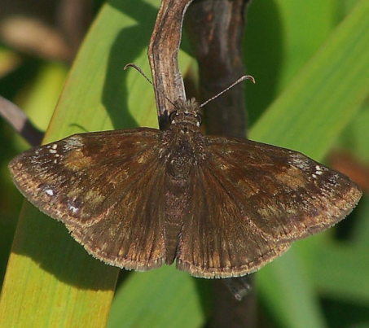
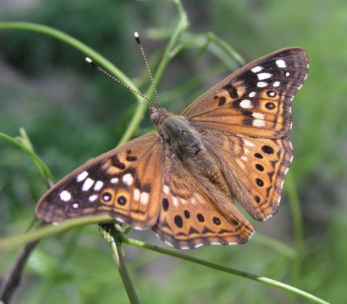
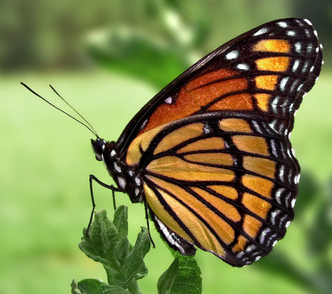
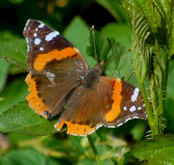
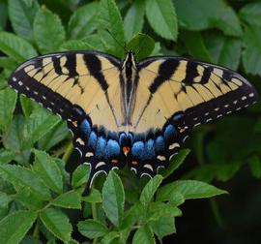
Cupido comyntas
Megisto cymela
Polites peckius
Speyeria cybele
Cercyonis pegala
Colias eurytheme
Papilio troilus
Pieris rapae
Phyciodes tharos
Celastrina ladon
Celastrina neglecta
Ancyloxypha numitor
Colias philodice
Epargyreus clarus
Thymelicus lineola
Fixed transect monitoring
March-October
20 species | 83 sites | 13 years
Erynnis baptisiae
Asterocampa celtis
Limenitis archippus
Vanessa atalanta
Papilio glaucus

Slide 13
Geographic warming
6 °C range of mean and maximum temperatures
Mimics IPCC climate change projections

Slide 14
Geographic warming
Urbanization
Impervious surfaces – roads, sidewalks, buildings
Proxy for urbanization effects
Impervious surface explains 90% of the variance in urban surface temperature in the Northeastern US; uncorrelated with geographic temp.
Urban temperatures and non-thermal aspects of urbanization largely unknown

Slide 15
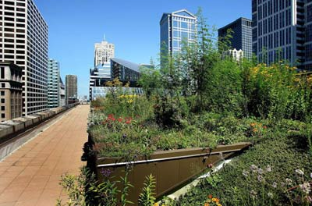
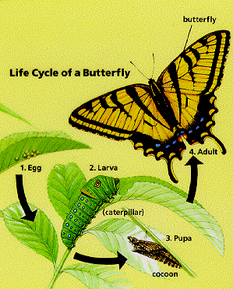
+1-3 °C air
What temperature changes are urban butterflies experiencing?
+5-8 °C surface
Immature developmental stages (eggs, larvae, pupae)
dependent on host plants
experience warmer surface temperatures
Cumulative effects throughout ontogeny influence adult emergence/flight
Impervious surfaces – roads, sidewalks, buildings
Proxy for urbanization effects
Impervious surface explains 90% of the variance in surface temperature in the Northeastern US
Urban temperatures and non-thermal aspects of urbanization largely unknown

Slide 16
Geographic warming
Urbanization
83 sites covering range of geographic warming and urbanization

Slide 17
20 species | 83 sites | 13 years
Cupido comyntas | site 8 | 2008
Eastern Tailed-Blue
Phenology
Ordinal date first appearance
Ordinal date peak appearance
Ordinal date last appearance
Flight breadth (last – first date)

Slide 18
Urbanization
Diamond et al. in revision Glob Change Biol

Slide 19
Rural butterflies advance with climate warming
Urban butterflies delay with climate warming
Urbanization
Diamond et al. in revision Glob Change Biol

Slide 20
Will the joint impacts of climate warming and urbanization continue to shift phenology earlier?
Effects are non-additive for Ohio butterflies
Urbanization
Diamond et al. in revision Glob Change Biol

Slide 21
Individual species first appearance responses

Slide 22
Using butterfly species’ traits to resolve variation in phenology
Trait-based model selection approach

Slide 23
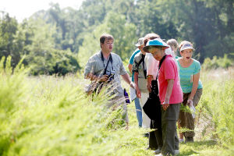
Butterfly responses to urban and climate warming
Citizen science for large scale monitoring,
and promoting conservation
Effects of urbanization are contingent upon climate warming
Non-additive effects of urbanization and climate change
Notes:
: their joint impacts produce qualitatively different results from their individual impacts

